Slide 1


CSE3150 – Front-end Full Stack Development
Department of Computer Science Engineering
School of Engineering

Slide 2
Module 2 - Syllabus
[Lecture-5 Hrs, Practical-6 Hrs, Application]
BootStrap for Responsive Web Design;
JavaScript – Core syntax, HTML DOM, objects, classes, Async;
Ajax and jQuery Introduction.

Slide 3
Module 2 - Syllabus
BootStrap for Responsive Web Design

Slide 4
Responsive Web Design
Introduction
Viewport
Grid View
Media Queries
Images
Videos
Frameworks
Templates

Slide 5
Responsive Web Design
The process of building websites & online portals with a stronger CX/UX (customer/user experience) optimal view solutions on a web page with the best browser compatibility that can run & operate in a variety of devices is known as responsive web design.

Slide 6
Responsive Web Design
Responsive web design makes your web page look good on all devices.
Responsive web design uses only HTML and CSS.
Responsive web design is not a program or a JavaScript.
Web pages can be viewed using many different devices: desktops, tablets, and phones.
Your web page should look good, and be easy to use, regardless of the device.

Slide 7
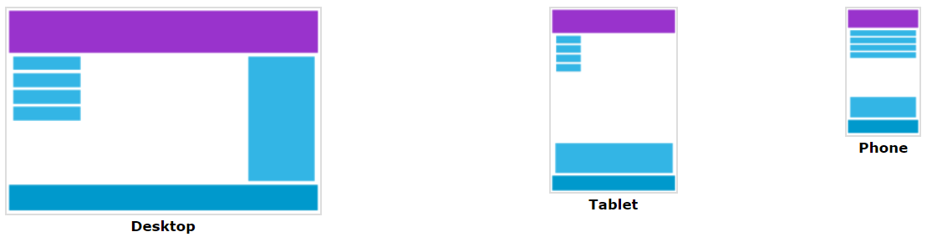
Responsive Web Design
Web pages should not leave out information to fit smaller devices, but rather adapt its content to fit any device.
It is called responsive web design when you use CSS and HTML to resize, hide, shrink, enlarge, or move the content to make it look good on any screen.

Slide 8
Responsive Web Design
Responsive web design is a suitable, robust, & fast solution that enables lesser efforts from the developers’ end.
Ethan Marcotte first described responsive web design as responding to the needs of people and the devices they are utilizing.
Depending on the size and capabilities of the gadget, the layout alters.
E.g.: With a phone, consumers might see content presented in a single column perspective; on a tablet, the same content might be presented in two columns.

Slide 9
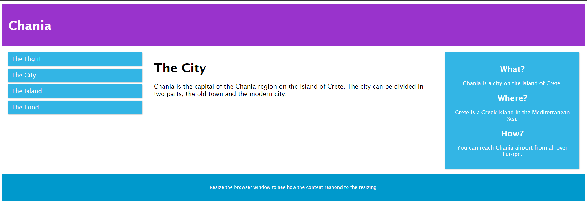
Responsive Web Design - Example
Refer Pgm1

Slide 10
Responsive Web Design
Introduction
Viewport
Grid View
Media Queries
Images
Videos
Frameworks
Templates

Slide 11
Viewport
The viewport is the user's visible area of a web page.
The viewport varies with the device, and will be smaller on a mobile phone than on a computer screen.

Slide 12
Setting The Viewport
HTML5 introduced a method to let web designers take control over the viewport, through the <meta> tag.
<meta name="viewport" content="width=device-width, initial-scale=1.0">
This gives the browser instructions on how to control the page's dimensions & scaling.
The width=device-width part sets the width of the page to follow the screen-width of the device (which will vary depending on the device).
The initial-scale=1.0 part sets the initial zoom level when the page is first loaded by the browser.

Slide 13
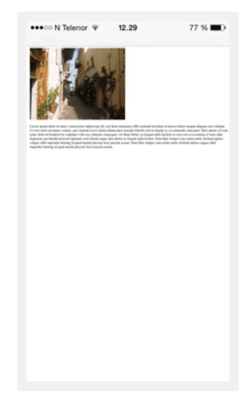
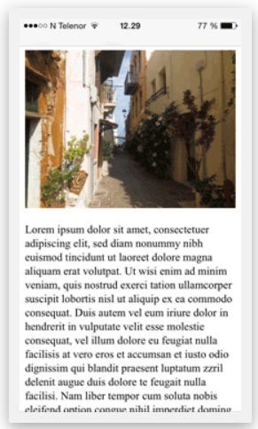
Setting The Viewport
Without the viewport meta tag
With the viewport meta tag

Slide 14
Responsive Web Design
Introduction
Viewport
Grid View
Media Queries
Images
Videos
Frameworks
Templates

Slide 15
Grid View
Many web pages are based on a grid-view, which means that the page is divided into columns
Using a grid-view is very helpful when designing web pages.
It makes it easier to place elements on the page.
A responsive grid-view often has 12 columns, and has a total width of 100%, and will shrink & expand as you resize the browser window.

Slide 16
Building a Responsive Grid-View
All HTML elements have the box-sizing property set to border-box.
This makes sure that the padding and border are included in the total width and height of the elements.
* { box-sizing: border-box; }
.menu { width: 25%; float: left; } .main { width: 75%; float: left; }

Slide 17
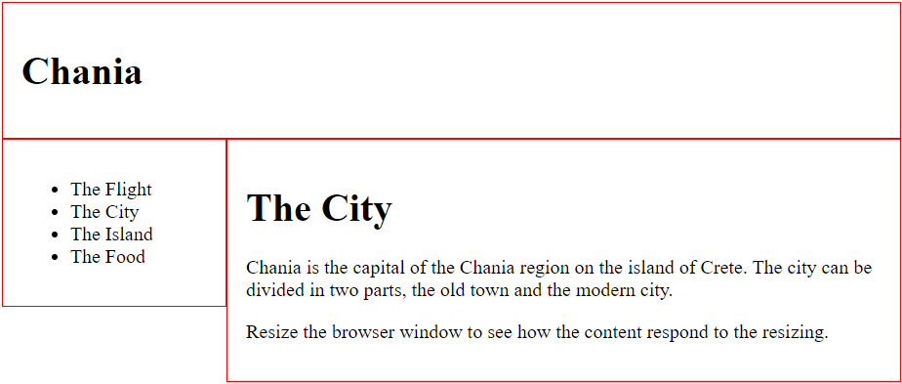
Building a Responsive Grid-View - Example
Refer Pgm2

Slide 18
Responsive Web Design
Introduction
Viewport
Grid View
Media Queries
Images
Videos
Frameworks
Templates

Slide 19
Media Queries
Media query is a CSS technique introduced in CSS3.
It uses the @media rule to include a block of CSS properties only if a certain condition is true.
E.g.: If the browser window is 600px or smaller, the background color will be lightblue
@media only screen and (max-width: 600px) { body { background-color: lightblue; } }

Slide 20
Media Queries
Use a media query to add a breakpoint at 768px:
/* For desktop: */ .col-1 {width: 8.33%;} .col-2 {width: 16.66%;} .col-3 {width: 25%;} .col-4 {width: 33.33%;} .col-5 {width: 41.66%;} .col-6 {width: 50%;} .col-7 {width: 58.33%;} .col-8 {width: 66.66%;} .col-9 {width: 75%;} .col-10 {width: 83.33%;} .col-11 {width: 91.66%;} .col-12 {width: 100%;} @media only screen and (max-width: 768px) { /* For mobile phones: */ [class*="col-"] { width: 100%; } }

Slide 21
Typical Device Breakpoints
/* Extra small devices (phones, 600px and down) */ @media only screen and (max-width: 600px) {...} /* Small devices (portrait tablets and large phones, 600px and up) */ @media only screen and (min-width: 600px) {...} /* Medium devices (landscape tablets, 768px and up) */ @media only screen and (min-width: 768px) {...} /* Large devices (laptops/desktops, 992px and up) */ @media only screen and (min-width: 992px) {...} /* Extra large devices (large laptops and desktops, 1200px and up) */ @media only screen and (min-width: 1200px) {...}

Slide 22
Responsive Web Design
Introduction
Viewport
Grid View
Media Queries
Images
Videos
Frameworks
Templates

Slide 23
Images – Using the width & max-width Property
If the width property is set to a percentage and the height property is set to "auto", the image will be responsive and scale up and down
img { width: 100%; height: auto; }
If the max-width property is set to 100%, the image will scale down if it has to, but never scale up to be larger than its original size
img { max-width: 100%; height: auto; }

Slide 24
Images - Background Images
Background images can also respond to resizing & scaling.
3 different methods
If the background-size property is set to "contain", the background image will scale, and try to fit the content area. However, the image will keep its aspect ratio (the proportional relationship between the image's width and height)
If the background-size property is set to "100% 100%", the background image will stretch to cover the entire content area.
If the background-size property is set to "cover", the background image will scale to cover the entire content area. Here, the "cover" value keeps the aspect ratio, and some part of the background image may be clipped.

Slide 25
Responsive Web Design
Introduction
Viewport
Grid View
Media Queries
Images
Videos
Frameworks
Templates

Slide 26
Videos - Add a Video
When we want to add a video in our web page, the video will be resized to always take up all the available space

Slide 27
Responsive Web Design
Introduction
Viewport
Grid View
Media Queries
Images
Videos
Frameworks
Templates

Slide 28
Frameworks
There are many free CSS Frameworks that offer Responsive Design.
A popular framework is Bootstrap. It uses HTML and CSS to make responsive web pages.
Other Frameworks
Tailwind CSS
Bulma
Materialize
Foundation by Zurb
Pure CSS
Element
Skeleton
Metro UI
Powertocss

Slide 29
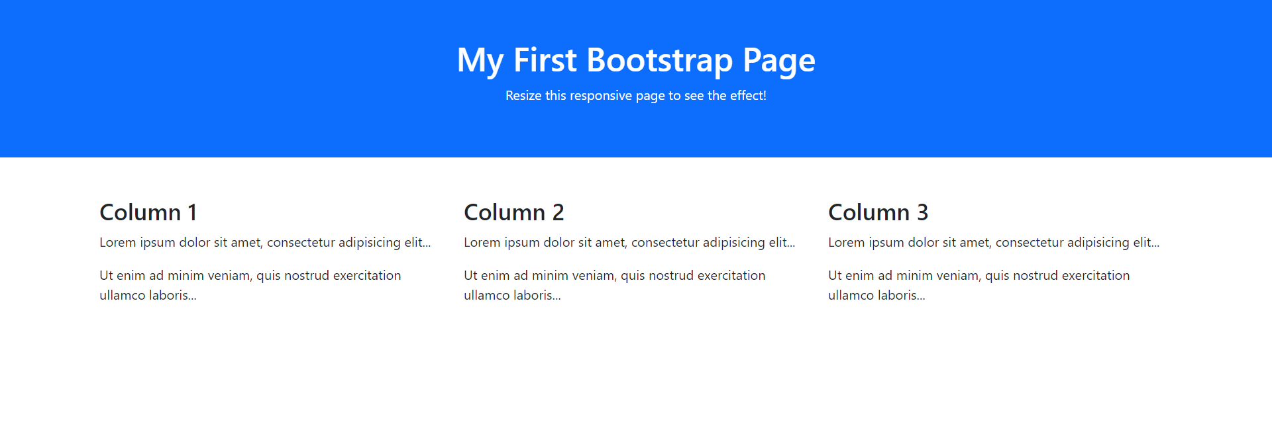
Frameworks – Bootstrap – Example
Refer Pgm3

Slide 30
Responsive Web Design
Introduction
Viewport
Grid View
Media Queries
Images
Videos
Frameworks
Templates

Slide 31
Templates
There are some responsive templates available with the CSS framework.
You are free to modify, save, share, and use them in all your projects.
E.g.:
Ecommerce
Education
Restaurant
Art Template
Architect Template
Blog Template
CV Template

Slide 32
Responsive Web Design (Completed)
Introduction
Viewport
Grid View
Media Queries
Images
Videos
Frameworks
Templates

Slide 33
Bootstrap
Introduction
Create Your First Web Page With Bootstrap 5
Containers
Grid System
Colors
Tables
Images
Buttons
Elements
Forms
Select menu
Validation
Components

Slide 34
Bootstrap
Bootstrap 5 is the newest version of Bootstrap, which is the most popular HTML, CSS, and JavaScript framework for creating responsive, mobile-first websites.
Bootstrap is a free and open-source CSS framework directed at responsive, mobile-first front-end web development.
It contains HTML, CSS and JavaScript-based design templates for typography, forms, buttons, navigation, & other interface components.
Bootstrap is a free front-end framework for faster and easier web development

Slide 35
Bootstrap
Bootstrap was developed by Mark Otto and Jacob Thornton at Twitter, and released as an open source product in August 2011 on GitHub.
It contains pre-built components and design elements to style HTML content.
Modern browsers such as Chrome, Firefox, Opera, Safari, & Internet Explorer support Bootstrap.
How to Use :
Download Bootstrap from getbootstrap.com
Include Bootstrap from a CDN

Slide 36
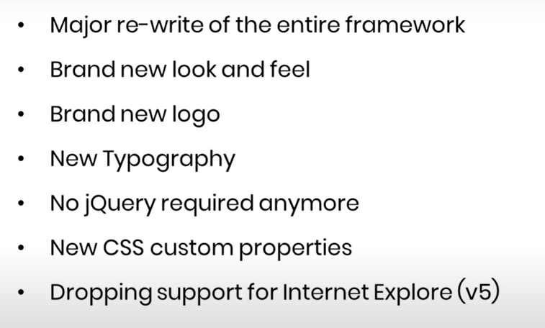
Bootstrap

Slide 37
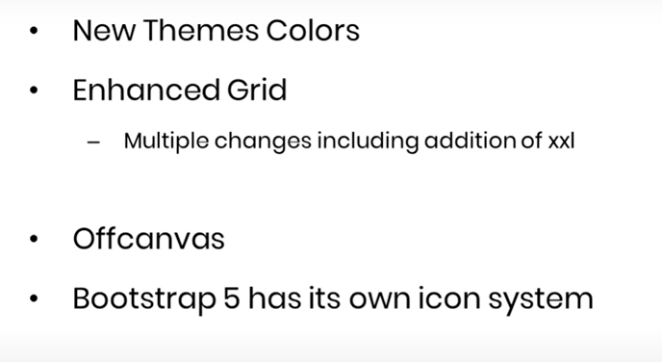
Bootstrap

Slide 38
Bootstrap
Download Bootstrap from getbootstrap.com
If you want to download and host Bootstrap yourself, go to getbootstrap.com, and follow the instructions there.
Include Bootstrap from a CDN
If you don't want to download and host Bootstrap yourself, you can include it from a CDN (Content Delivery Network).
MaxCDN provides CDN support for Bootstrap's CSS and JavaScript. You must also include jQuery.

Slide 39
Bootstrap CDN
You must include the following Bootstrap’s CSS, JavaScript, and jQuery from MaxCDN into your web page.
<!-- Latest compiled and minified Bootstrap CSS --> <link rel="stylesheet"href="https://maxcdn.bootstrapcdn.com/bootstrap/3.3.7/css/bootstrap.min.css">
<!-- Latest compiled Bootstrap JavaScript --> <script src="https://maxcdn.bootstrapcdn.com/bootstrap/3.3.7/js/bootstrap.min.js"></script>
<!-- latest jQuery library --> <script src="https://code.jquery.com/jquerylatest.js"></script>

Slide 40
Advantages of Bootstrap
Easy to use: Anybody with just basic knowledge of HTML and CSS can start using Bootstrap
Responsive features: Bootstrap's responsive CSS adjusts to phones, tablets, and desktops
Mobile-first approach: In Bootstrap 3, mobile-first styles are part of the core framework
Browser compatibility: Bootstrap is compatible with all modern browsers (Chrome, Firefox, Internet Explorer, Safari, and Opera)

Slide 41
Advantage of using the Bootstrap CDN
Many users already have downloaded Bootstrap from MaxCDN when visiting another site. As a result, it will be loaded from cache when they visit your site, which leads to faster loading time.
Also, most CDN's will make sure that once a user requests a file from it, it will be served from the server closest to them, which also leads to faster loading time.

Slide 42
Create Your First Web Page With Bootstrap 5
Bootstrap 5 uses HTML elements and CSS properties that require the HTML5 doctype.
Always include the HTML5 doctype at the beginning of the page, along with the lang attribute and the correct title and character set
<!DOCTYPE html> <html lang="en"> <head> <title>Bootstrap 5 Example</title> <meta charset="utf-8"> </head> </html>

Slide 43
Bootstrap 5 is mobile-first
Bootstrap 5 is designed to be responsive to mobile devices.
Mobile-first styles are part of the core framework.
To ensure proper rendering and touch zooming, add the following <meta> tag inside the <head> element.
<meta name="viewport" content="width=device-width, initial-scale=1">
The width=device-width part sets the width of the page to follow the screen-width of the device (which will vary depending on the device).
The initial-scale=1 part sets the initial zoom level when the page is first loaded by the browser.

Slide 44
Containers
Bootstrap 5 also requires a containing element to wrap site contents.
There are 2 container classes to choose from:
The .container class provides a responsive fixed width container
The .container-fluid class provides a full width container, spanning the entire width of the viewport

Slide 45

Containers
Bootstrap 5 also requires a containing element to wrap site contents.
There are 2 container classes to choose from:
The .container class provides a responsive fixed width container
The .container-fluid class provides a full width container, spanning the entire width of the viewport

Slide 46
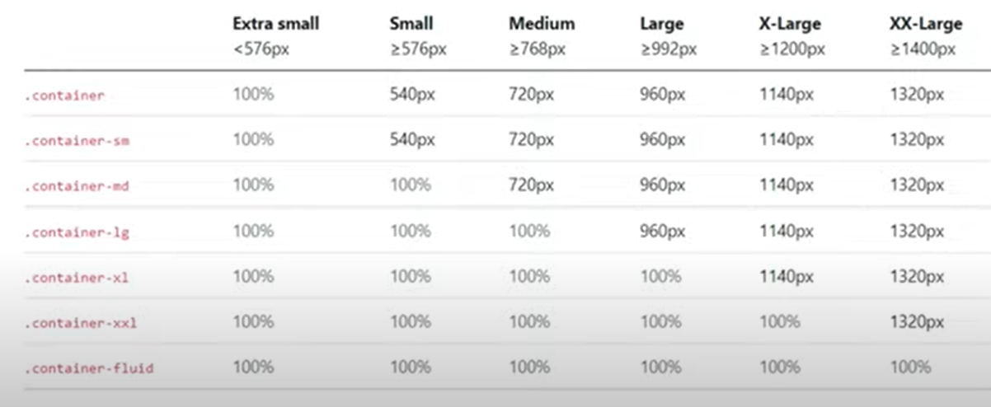
Containers

Slide 47
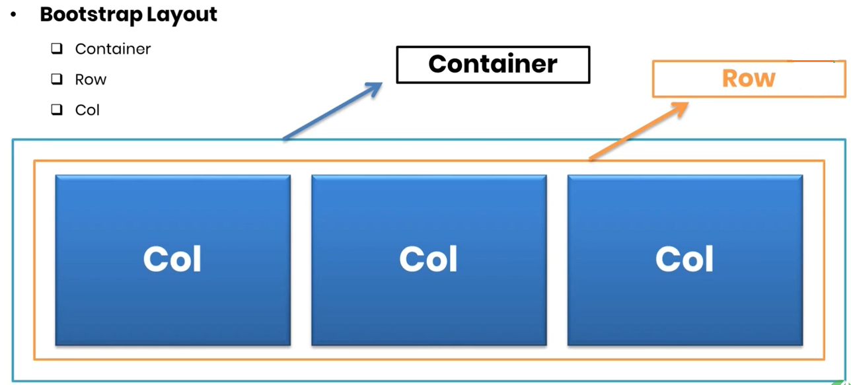
Grid System

Slide 48
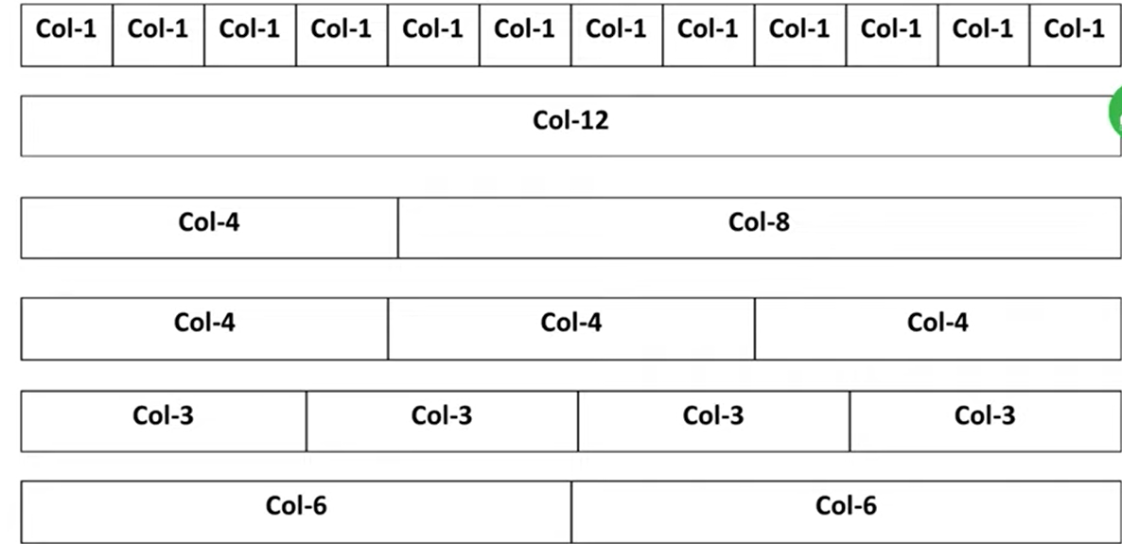
Grid System
Bootstrap's grid system is built with flexbox and allows up to 12 columns across the page.
If you do not want to use all 12 columns individually, you can group the columns together to create wider columns

Slide 49
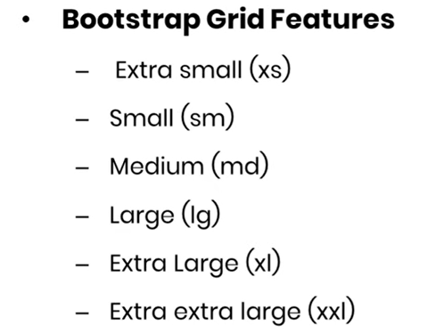
Grid System

Slide 50
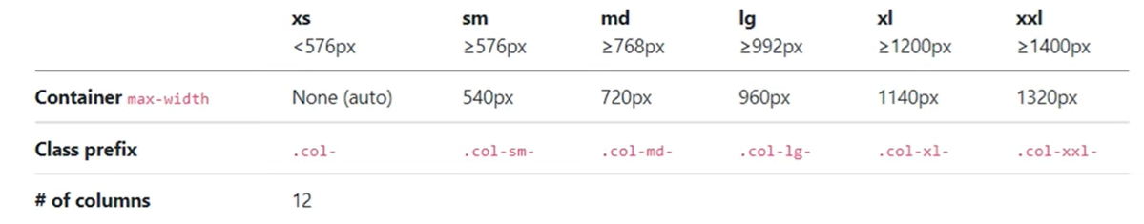
Grid Classes
The Bootstrap 5 grid system has six classes:
.col- (extra small devices - screen width less than 576px)
.col-sm- (small devices - screen width equal to or greater than 576px)
.col-md- (medium devices - screen width equal to or greater than 768px)
.col-lg- (large devices - screen width equal to or greater than 992px)
.col-xl- (xlarge devices - screen width equal to or greater than 1200px)
.col-xxl- (xxlarge devices - screen width equal to or greater than 1400px)

Slide 51
Colors
Bootstrap 5 has some contextual classes that can be used to provide "meaning through colors".
The classes for text colors are:
.text-muted, .text-primary, .text-success, .text-info, .text-warning, .text-danger, .text-secondary, .text-white, .text-dark, .text-body (default body color/often black) and .text-light

Slide 52
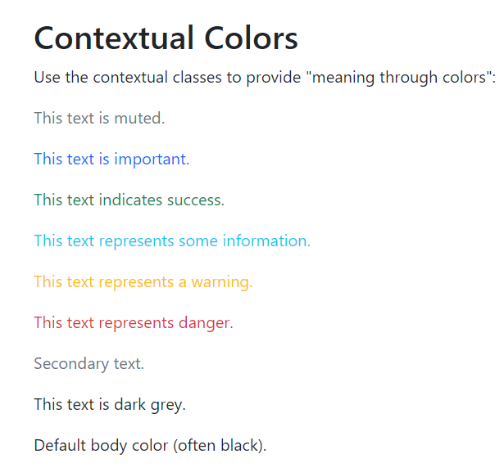
Colors – Example
Refer Pgm4

Slide 53
Tables
A basic Bootstrap 5 table has a light padding and horizontal dividers.
The .table class adds basic styling to a table
The .table-striped class adds zebra-stripes to a table
The .table-bordered class adds borders on all sides of the table and cells
The .table-hover class adds a hover effect (grey background color) on table rows
The .table-dark class adds a black background to the table
Combine .table-dark and .table-striped to create a dark, striped table
The .table-borderless class removes borders from the table
The .table-sm class makes the table smaller by cutting cell padding in half
The .table-responsive class adds a scrollbar to the table when needed (when it is too big horizontally)

Slide 54
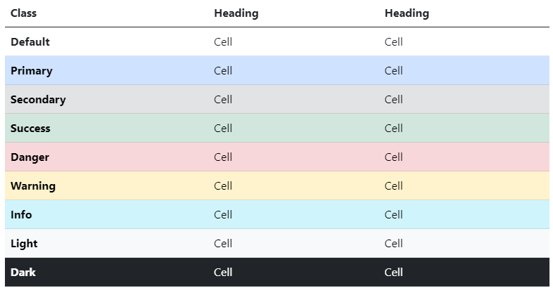
Tables(Variants)
Use contextual classes to color tables, table rows or individual cells.

Slide 55
Tables(Variants)
<!-- On tables -->
<table class="table-primary">...</table>
<table class="table-secondary">...</table>
<table class="table-success">...</table>
<table class="table-danger">...</table>
<table class="table-warning">...</table>
<table class="table-info">...</table>
<table class="table-light">...</table>
<table class="table-dark">...</table>
<!-- On rows -->
<tr class="table-primary">...</tr>
<tr class="table-secondary">...</tr>
<tr class="table-success">...</tr>
<tr class="table-danger">...</tr>
<tr class="table-warning">...</tr>
<tr class="table-info">...</tr>
<tr class="table-light">...</tr>
<tr class="table-dark">...</tr>

Slide 56
Tables(Variants)
<!-- On cells (`td` or `th`) -->
<tr> <td class="table-primary">...</td>
<td class="table-secondary">...</td>
<td class="table-success">...</td>
<td class="table-danger">...</td>
<td class="table-warning">...</td>
<td class="table-info">...</td>
<td class="table-light">...</td>
<td class="table-dark">...</td> </tr>

Slide 57
Images
Rounded Corners
The .img-rounded class adds rounded corners to an image (IE8 does not support rounded corners)
Circle
The .img-rounded-circle class shapes the image to a circle (IE8 does not support rounded corners)
Thumbnail
The .img-thumbnail class shapes the image to a thumbnail

Slide 58
Images
Responsive Images
Images comes in all sizes. So do screens. Responsive images automatically adjust to fit the size of the screen.
Create responsive images by adding an .img-responsive class to the <img> tag. The image will then scale nicely to the parent element.
The .img-responsive class applies display: block; and max-width: 100%; and height: auto; to the image

Slide 59
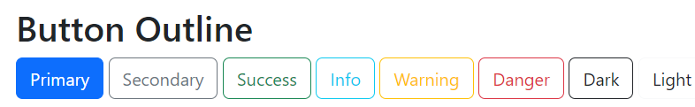
Buttons
Bootstrap includes several predefined button styles, each serving its own semantic purpose, with a few extras thrown in for more control.
Bootstrap provides seven styles of buttons with the following classes:
.btn-default
.btn-primary
.btn-success
.btn-info
.btn-warning
.btn-danger
.btn-link
Refer Pgm5

Slide 60
Button Sizes
Bootstrap provides 4 button sizes with the following classes:
.btn-lg
.btn-md
.btn-sm
.btn-xs

Slide 61
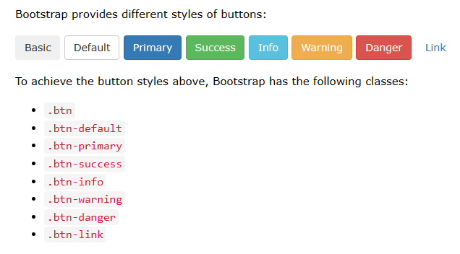
Button Sizes

Slide 62
Elements
The button classes can be used on the following elements:
<a>
<button>
<input>

Slide 63
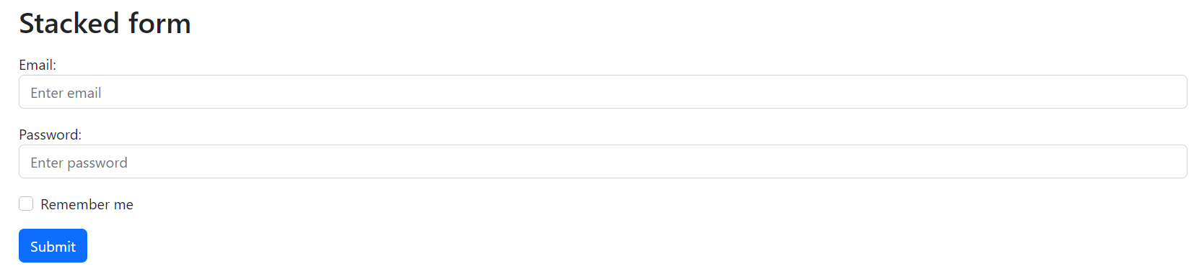
Forms – Stacked Form
All textual <input> and <textarea> elements with class .form-control get proper form styling
Refer Pgm6

Slide 64
Select - Select Menu
Select menu (select one)
Multiple select menu (hold ctrl or shift (or drag with the mouse) to select more than one)
Select menus are used if you want to allow the user to pick from multiple options.
To style a select menu in Bootstrap 5, add the .form-select class to the <select> element:

Slide 65
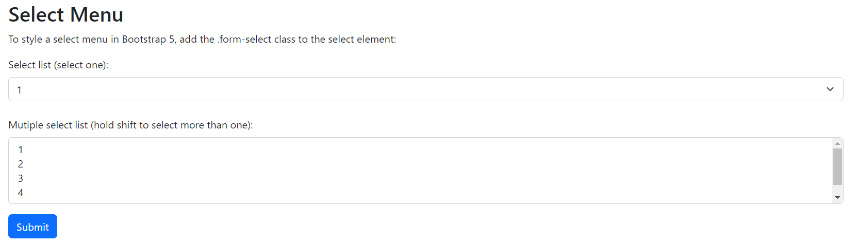
Select - Select Menu – Example
Refer Pgm7

Slide 66
Validation - Form Validation
You can use different validation classes to provide valuable feedback to users.
Add either .was-validated or .needs-validation to the <form> element, depending on whether you want to provide validation feedback before or after submitting the form.
The input fields will have a green (valid) or red (invalid) border to indicate what's missing in the form.
You can also add a .valid-feedback or .invalid-feedback message to tell the user explicitly what's missing, or needs to be done before submitting the form.

Slide 67
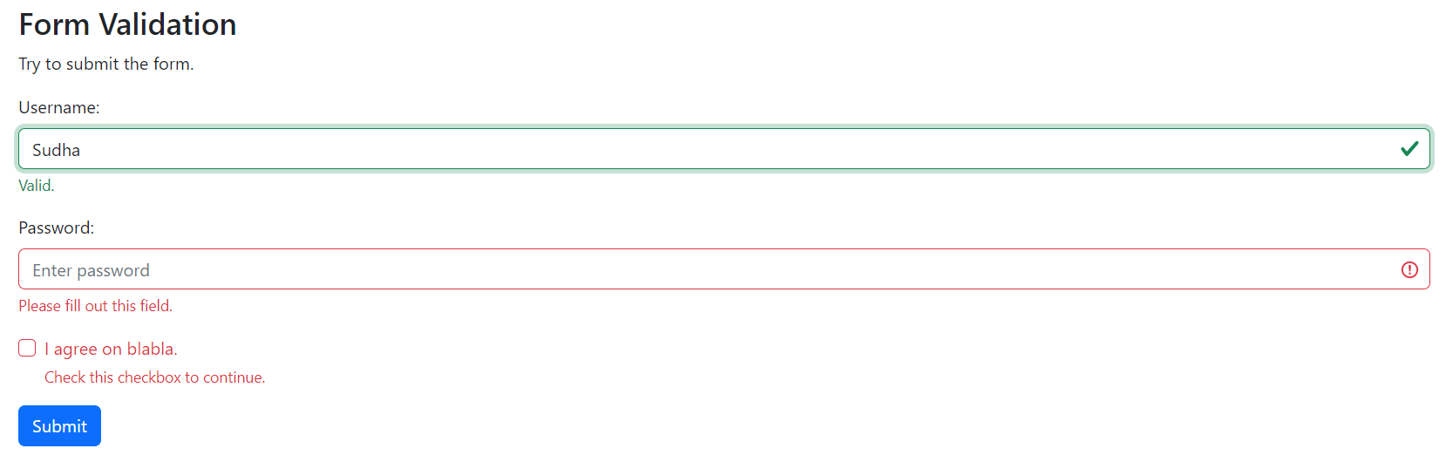
Validation - Form Validation
Refer Pgm8

Slide 68
Spacing
Bootstrap 4 has a wide range of responsive margin and padding utility classes. They work for all breakpoints: xs (<=576px), sm (>=576px), md (>=768px), lg (>=992px) or xl (>=1200px)):
The classes are used in the format: {property}{sides} {size} for xs and {property}{sides}-{breakpoint}-{size} for sm, md, lg, and xl.
Where property is one of:
m - sets margin
p - sets padding

Slide 69
Spacing
Where sides is one of:
t - sets margin-top or padding-top
b - sets margin-bottom or padding-bottom
l - sets margin-left or padding-left
r - sets margin-right or padding-right
x - sets both padding-left and padding-right or margin-left and margin-right
y - sets both padding-top and padding-bottom or margin-top and margin-bottom
blank - sets a margin or padding on all 4 sides of the element

Slide 70
Spacing
Where size is one of:
0 - sets margin or padding to 0
1 - sets margin or padding to .25rem (4px if font-size is 16px)
2 - sets margin or padding to .5rem (8px if font-size is 16px)
3 - sets margin or padding to 1rem (16px if font-size is 16px)
4 - sets margin or padding to 1.5rem (24px if font-size is 16px)
5 - sets margin or padding to 3rem (48px if font-size is 16px)
auto - sets margin to auto

Slide 71
Spacing
Bootstrap 4 Utilities (w3schools.com)-For height and width utilities

Slide 72
Components (Self study topics)
Accordion
Alerts
Badge
Breadcrumb
Buttons
Button group
Card
Carousel
Close button
Collapse
Dropdowns
List group
Modal
Navs & tabs
Navbar
Offcanvas
Pagination
Popovers
Progress
Scrollspy
Spinners
Toasts
Tooltips

Slide 73
Bootstrap (Completed)
Introduction
Create Your First Web Page With Bootstrap 5
Containers
Grid System
Colors
Tables
Images
Buttons
Elements
Forms
Select menu
Validation
Components

Slide 74
Module 2 - Syllabus
[Lecture-5 Hrs, Practical-6 Hrs, Application]
BootStrap for Responsive Web Design; (Completed)
JavaScript – Core syntax, HTML DOM, objects, classes, Async;
Ajax and jQuery Introduction.

Slide 75


